Slide 1

Candy Data analysis

Slide 2
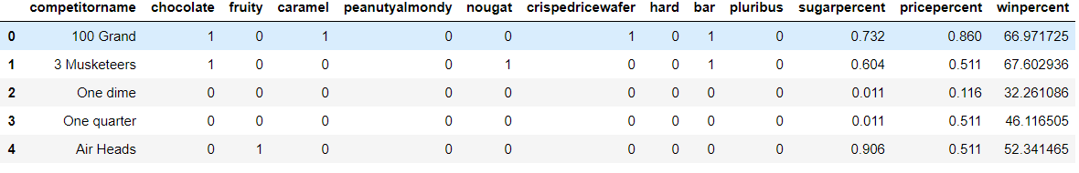
Let's Understanding the Data

Slide 3

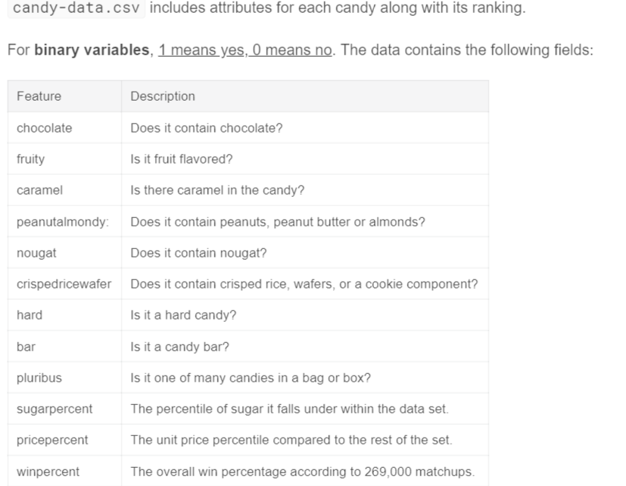



Contents of Data

Slide 4
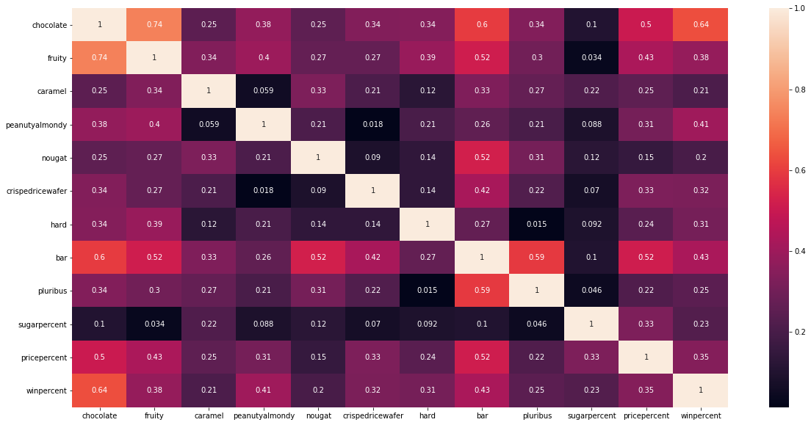
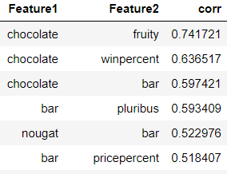
Correlation between the columns

Slide 5
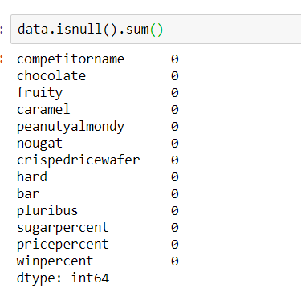
Missing Value Treatment
It seems there is no missing value in given dataset.
Hence, we don't need to do any missing value treatment

Slide 6

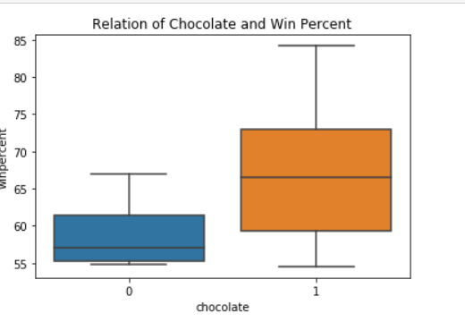
Univariate Analysis
More than 70% of the population likes Chocolate
This should be an important factor for higher win percentage

Slide 7
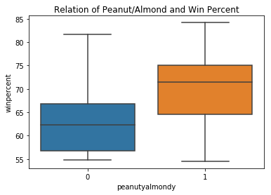
Univariate Analysis
Win percentage is very high when Peanut/Almond is used
This should be a very important factor for higher win percentage

Slide 8
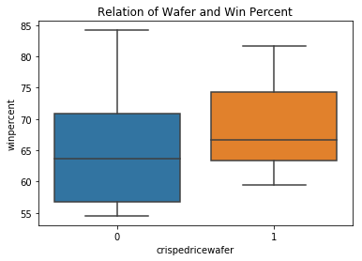
Univariate Analysis
More than 70% of the population likes crispedricewafer
This is also an important factor for higher win percentage

Slide 9
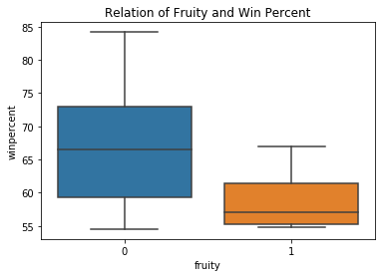
Univariate Analysis
Bigger part of the population does not like fruity in candy
This should be an important factor for less win percentage

Slide 10
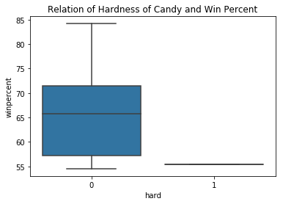
Univariate Analysis
Most of the population likes Soft Candies and almost no one likes hardness in candies
Softness should be an important factor for higher win percentage

Slide 11
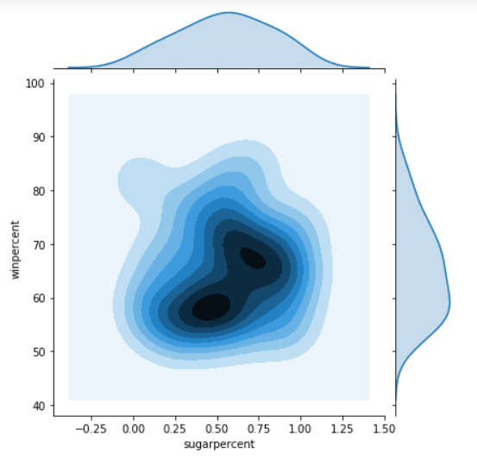
Bivariate Analysis
This plot proves that sugar percentage is not linear to the popularity of the candy
sugar content of candy doesn't contribute to the popularity of the candy

Slide 12
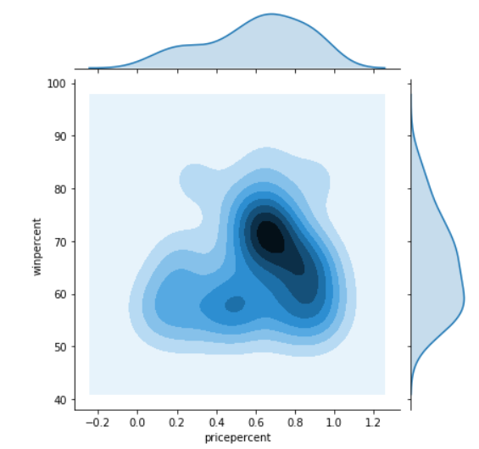
Bivariate Analysis
This plot proves that price percentage is also not linear to the popularity of the candy
cost of candy doesn't contribute to the popularity of the candy

Slide 13
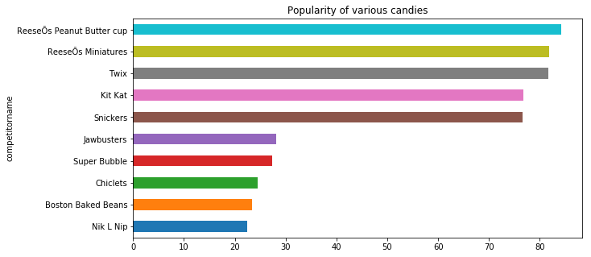
Most & Least Popular Candies

Slide 14
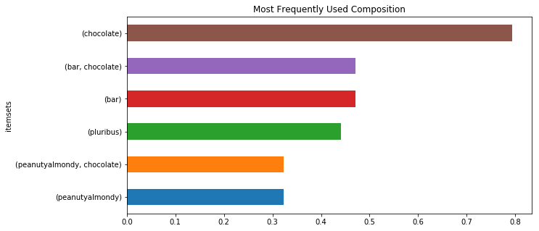
Most Frequently Used Composition

Slide 15
Let's Build The Machine Learning Models now

Slide 16
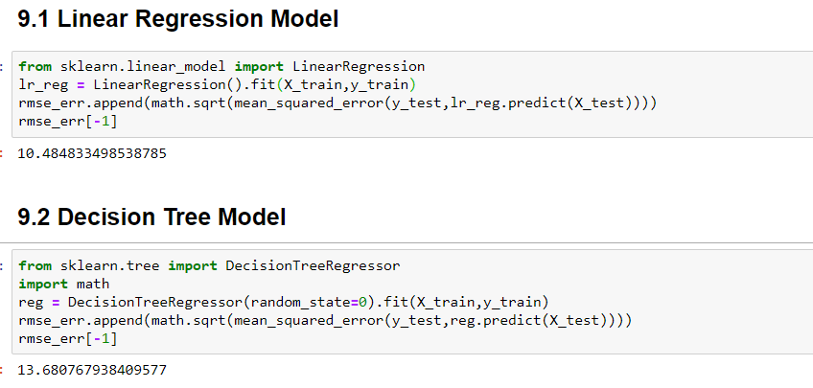
Linear & Decision Tree Model

Slide 17
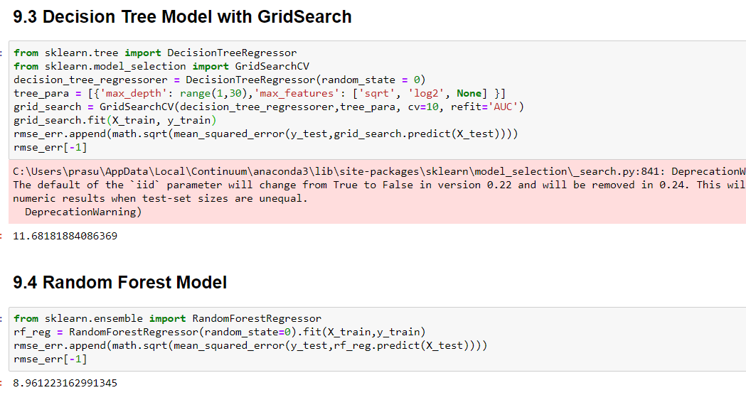
Decision Tree With Grid Search & Random forest Model

Slide 18
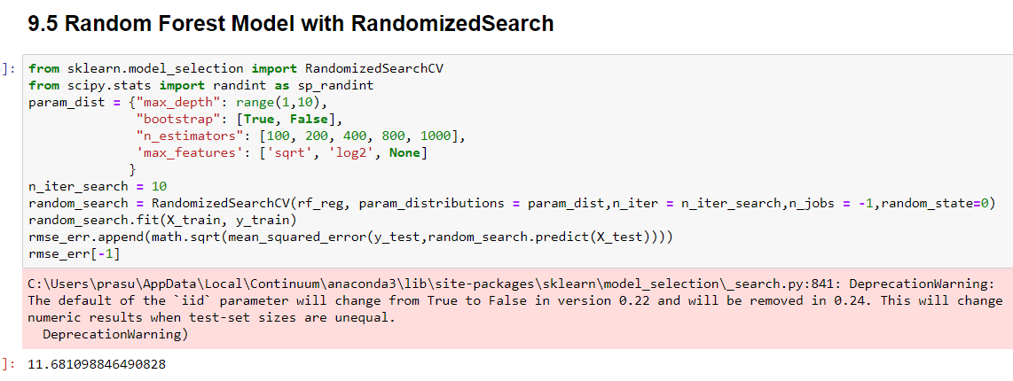
Random Forest with Randomized Search

Slide 19
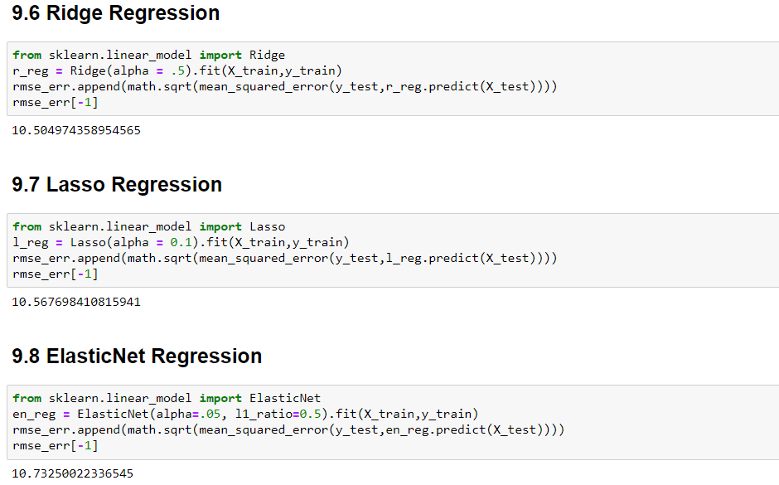
Ridge , Lasso & ElasticNet Regression Model

Slide 20
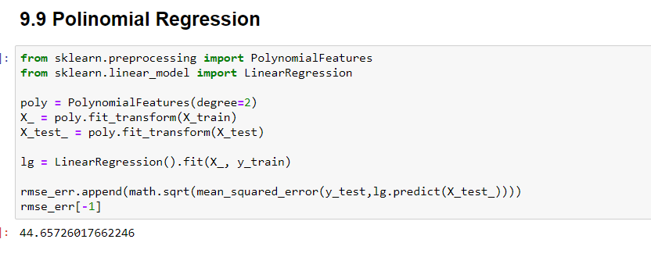
Polynomial Regresseion

Slide 21
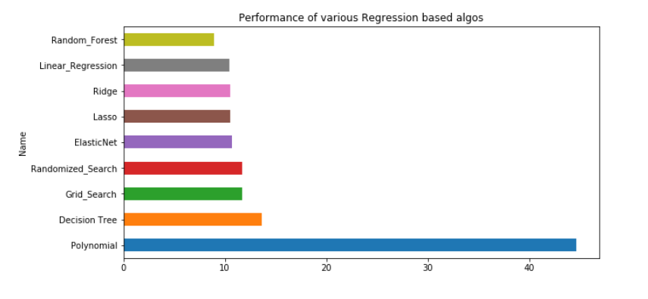
Random Forest Model seems to be the best fit Model. Polynomial Regression seems to be worst fit model.

Slide 22
THANK YOU

